Slide 1

ASURE: Trust Verified
Innovative solutions for secure verification
Presented by
Ahnaf Akib Ahmed - 2312304642 Tasmia Rashed Ramisha - 2312131042 Mohammad Zonayet Hassan Polok - 2031267642 Sumya Akter - 2111913642

Slide 2
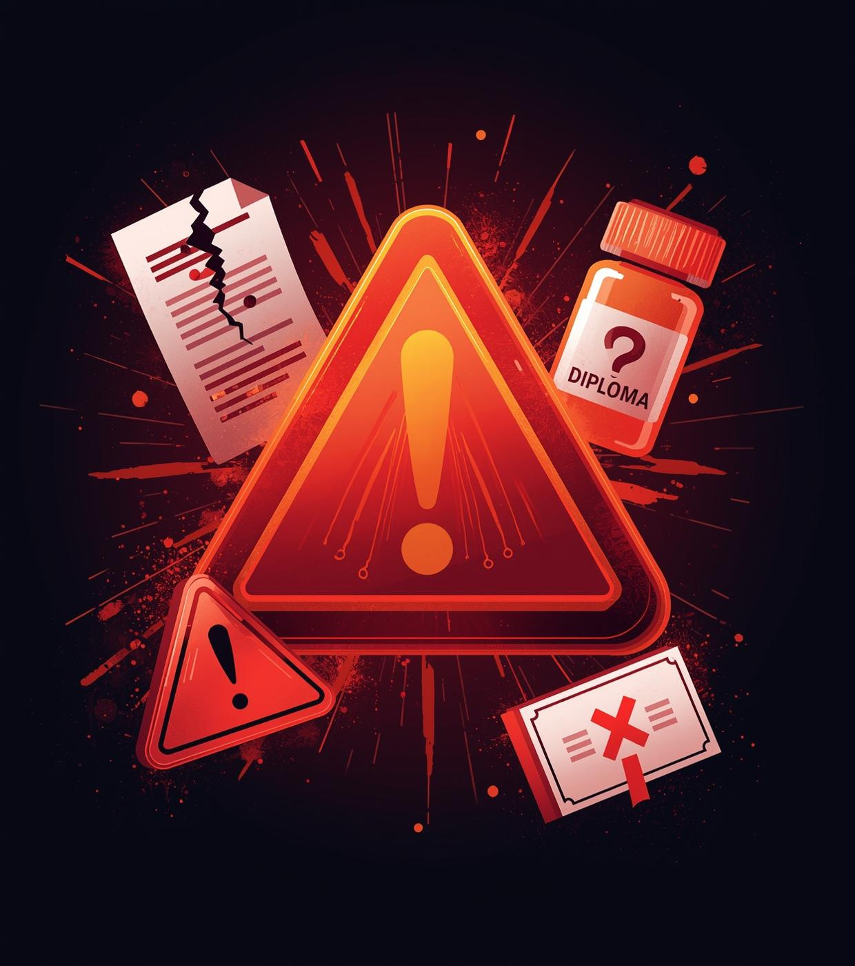
The Problem
Addressing the urgent issues of trust in verification processes
Fake certificates undermine credibility
Fake medicines pose serious health risks
Fake credentials affect employment integrity

Slide 3

75%
Trust Erosion
75% of people express concerns about the authenticity of certificates and credentials, leading to a significant decline in trust and increasing risks in various sectors.

Slide 4

ASURE: Your All-in-One Verification Platform
Instant AI Verification & suggestions for Certificates, Medicines and Any Random Products.

Slide 5

ASURE’s Core Functions
Comprehensive verification for certificates, medicines, and identities using advanced technology.
Verifies certificates for authenticity
Checks medicines for safety
Suggest medicines for patient
Suggest Related product Available in market and their prices

Slide 6

How ASURE Works
Upload a document or image or you can go through some Barcodes and Numbers and our advanced AI technology analyzes the data swiftly, delivering an instant result. This seamless process enhances security and ensures authenticity, making verification efficient and reliable for users.

Slide 7

Medicine Verification
Upload images for instant authenticity checks
“With ASURE, verification is as simple as taking a photo—ensuring safety and trust in every purchase.”

Slide 8
Need Suggestions about Medicine?
Upload images for instant suggestions for medicine
“With ASURE, get Ai suggestions for the patient.”

Slide 9
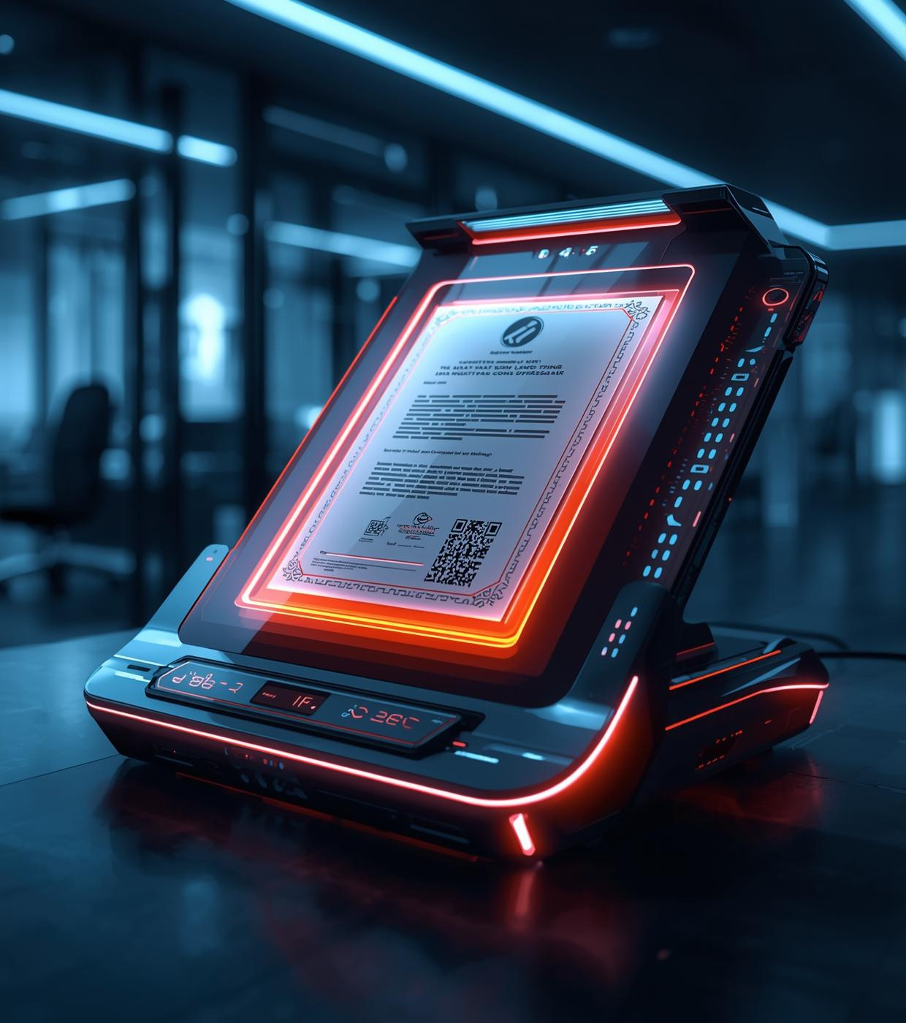
Streamlined Certificate Verification for Instant Results
Efficiently scan and extract information with ASURE technology and provide a rating out of 100

Slide 10

Want to be sure before purchase?
ASURE provide you all the details of your product you must have to see before any purchase and provide a rating .

Slide 11
Want to see available similar product and their price before purchase?
ASURE give you the information Where you can find the best and cheapest product.

Slide 12


Security Features
Lock Icon
Secure Login
Symbolizing strong data protection
Ensuring only authorized access

Slide 13

90%
Time Savings
ASURE reduces verification time from hours to seconds, enabling faster decision-making and enhancing efficiency for users across various sectors.

Slide 14


ASURE: Trusted by Diverse Institutions

Slide 15

95%
Customer Satisfaction Rate
10x
Faster Verification Speed
99.9%
Accuracy in Results

Slide 16
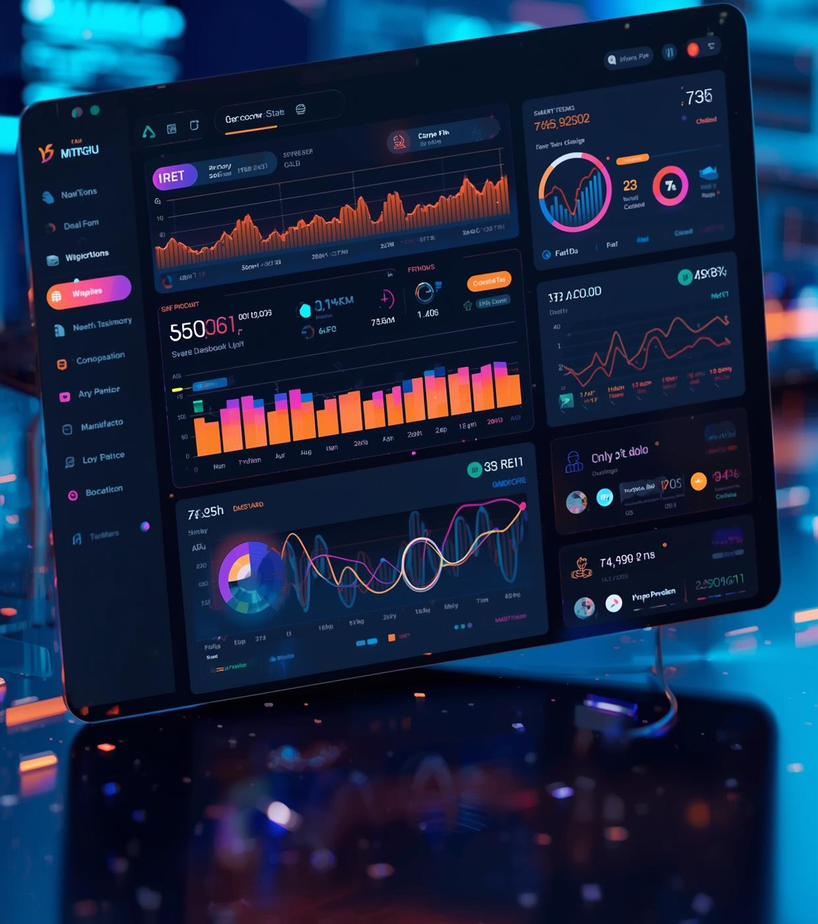
Production Ready: Fully Built System
ASURE's platform is now fully operational and secure, designed to meet the demands of modern verification needs. With extensive testing, it promises reliability and efficiency for all users, ready for immediate deployment.

Slide 17

ASURE is Available Now
Experience our cutting-edge platform with instant verification capabilities. ASURE is ready for use, providing a seamless and reliable solution for all your verification needs, ensuring trust and safety.

Slide 18

Why ASURE
The leading solution for trust, speed, and safety in verification
Trust: Verified and reliable results
Speed: Instant verification at your fingertips
Safety: Enhanced security measures for peace of mind

Slide 19

Future of AI
ASURE envisions a world where AI technology evolves to achieve greater accuracy and efficiency in verification processes, enabling seamless global interactions and fostering trust across diverse sectors by enhancing security measures and reliability.

Slide 20

Thank You
We appreciate your attention and welcome your questions

